Slide 1


ERA: Emergency Response Assist
Weekly Status Report
Jatin Madan; Sharvesh Patki; Isha Ghiria; Vaishnavi Desai
April 18, 2024

Slide 2
Objectives of ERA
Key Objectives
1.
Gunshot Detection and Localization: The emergency response system will incorporate gunshot detection and localization capabilities. This feature enhances the system's ability to swiftly identify and respond to active shooter incidents, further bolstering campus security and safety measures.
We have a desire to create a system that can assist people in case of emergencies by locating them and providing the safest exit routes to the affected.
To move toward achieving these goals, we need to build advanced machine learning and triangulation algorithms to assist the people
2.
Real-Time Tracking Algorithms: In conjunction with the existing features, the emergency response system will incorporate
real-time network tracking algorithms linked with network access points across the university campus. This feature enhances the system's ability to monitor and track the movement of individuals during emergencies, facilitating targeted assistance and evacuation procedures.
3.
Planning Escape Routes: In addition to advanced threat detection and real-time tracking capabilities, the emergency response system will integrate a feature for planning escape routes using the provided floor plans of university buildings and facilities. This feature will enhance the system's ability to guide individuals to safety during emergencies such as active shooter incidents, fires, or natural disasters.

Slide 3
The team will initiate several key activities during the first four (4) weeks, including but not limited to researching efficient algorithms to triangulate users and prepare an exit route for emergency situations
Key activities planned for the first four (4) weeks
Team ERA
Draft an Architectural Diagram for the ERA System
Build Mockups and Wireframes for the Frontend UI/UX of the application
Research on Escape Route Detection and Optimization Algorithms
Research Wi-Fi Access Point Metrics and Logs
Start daily sprint meetings with the team to review generalized use cases, identify gaps and improve collaboration.
WEEK 1-2
Create a simulation software for the Network Access Points to test User Triangulation
Setup CI/CD and DevSecOps Platform for ERA Software Management and Deployments
Start Developing UI from the designed Wireframes
Try and Validate Existing Route Detection ML Algorithms
Implement User Tracking and Triangulation
WEEK 2-4

Slide 4
Weekly status report – As of 04/18/2024
Current Project Status
Current Period | Previous Period | Trend | % Complete | Finish Date
 | - |  | 20% | 04/20/24
User Stories/Risks/Issues/Decisions/Milestones
R/I | Brief Description | Due Date
I | Finalize a Development Architecture for the ERA System | 04/16/2024
2 | Create a Simulation Software to generate Network Logs | 04/16/2024
3 | Create Mockups for Front-end UI | 04/16/2024
4 | Research on Escape Route Detection Algorithms | 04/16/2024
5 | Research on Wi Fi Access Point Logs and Metrics | 04/16/2024
G
Key Accomplishments: Finalized the Architecture Diagram for ERA System Implemented JIRA for Project management, and onboarded the team to the platform Setup Daily Standups to meet and collaborate on the ongoing efforts
Deliverables | Finish Date | % Complete | Status
 | (Planned)
Project plan | 05/05/24 | 15% | G
User stories for ERA Development operations | 05/05/24 | 65% | G
ERA System Architectural Diagram | 04/16/24 | 15% | C
Agile Release Roadmap | 04/20./24 | 5% | G
Completed 01 sprints and below is the snapshot of the current sprint [01]
Azure DevOps project archive | 05/05/24 | 0% | G
Perform Active User Simulation for ERA | 06/14/24 | 0% | G
ERA View/Update dashboard | 06/14/24 | 0% | G
Knowledge base articles for ERA System | 06/14/24 | 0% | G
Process workflow documentation | 06/14/24 | 0% | G
Activities planned for next period: Create a simulation software for the Network Access Points to test User Triangulation Setup CI/CD and DevSecOps Platform for ERA Software Management and Deployments Start Developing UI from the designed Wireframes Try and Validate Existing Route Detection ML Algorithms Implement User Tracking and Triangulation
G
On Track
A
Monitor Closely
C
Complete
Trending:
Improving trend for future
No change
Worsening trend for future

Slide 5
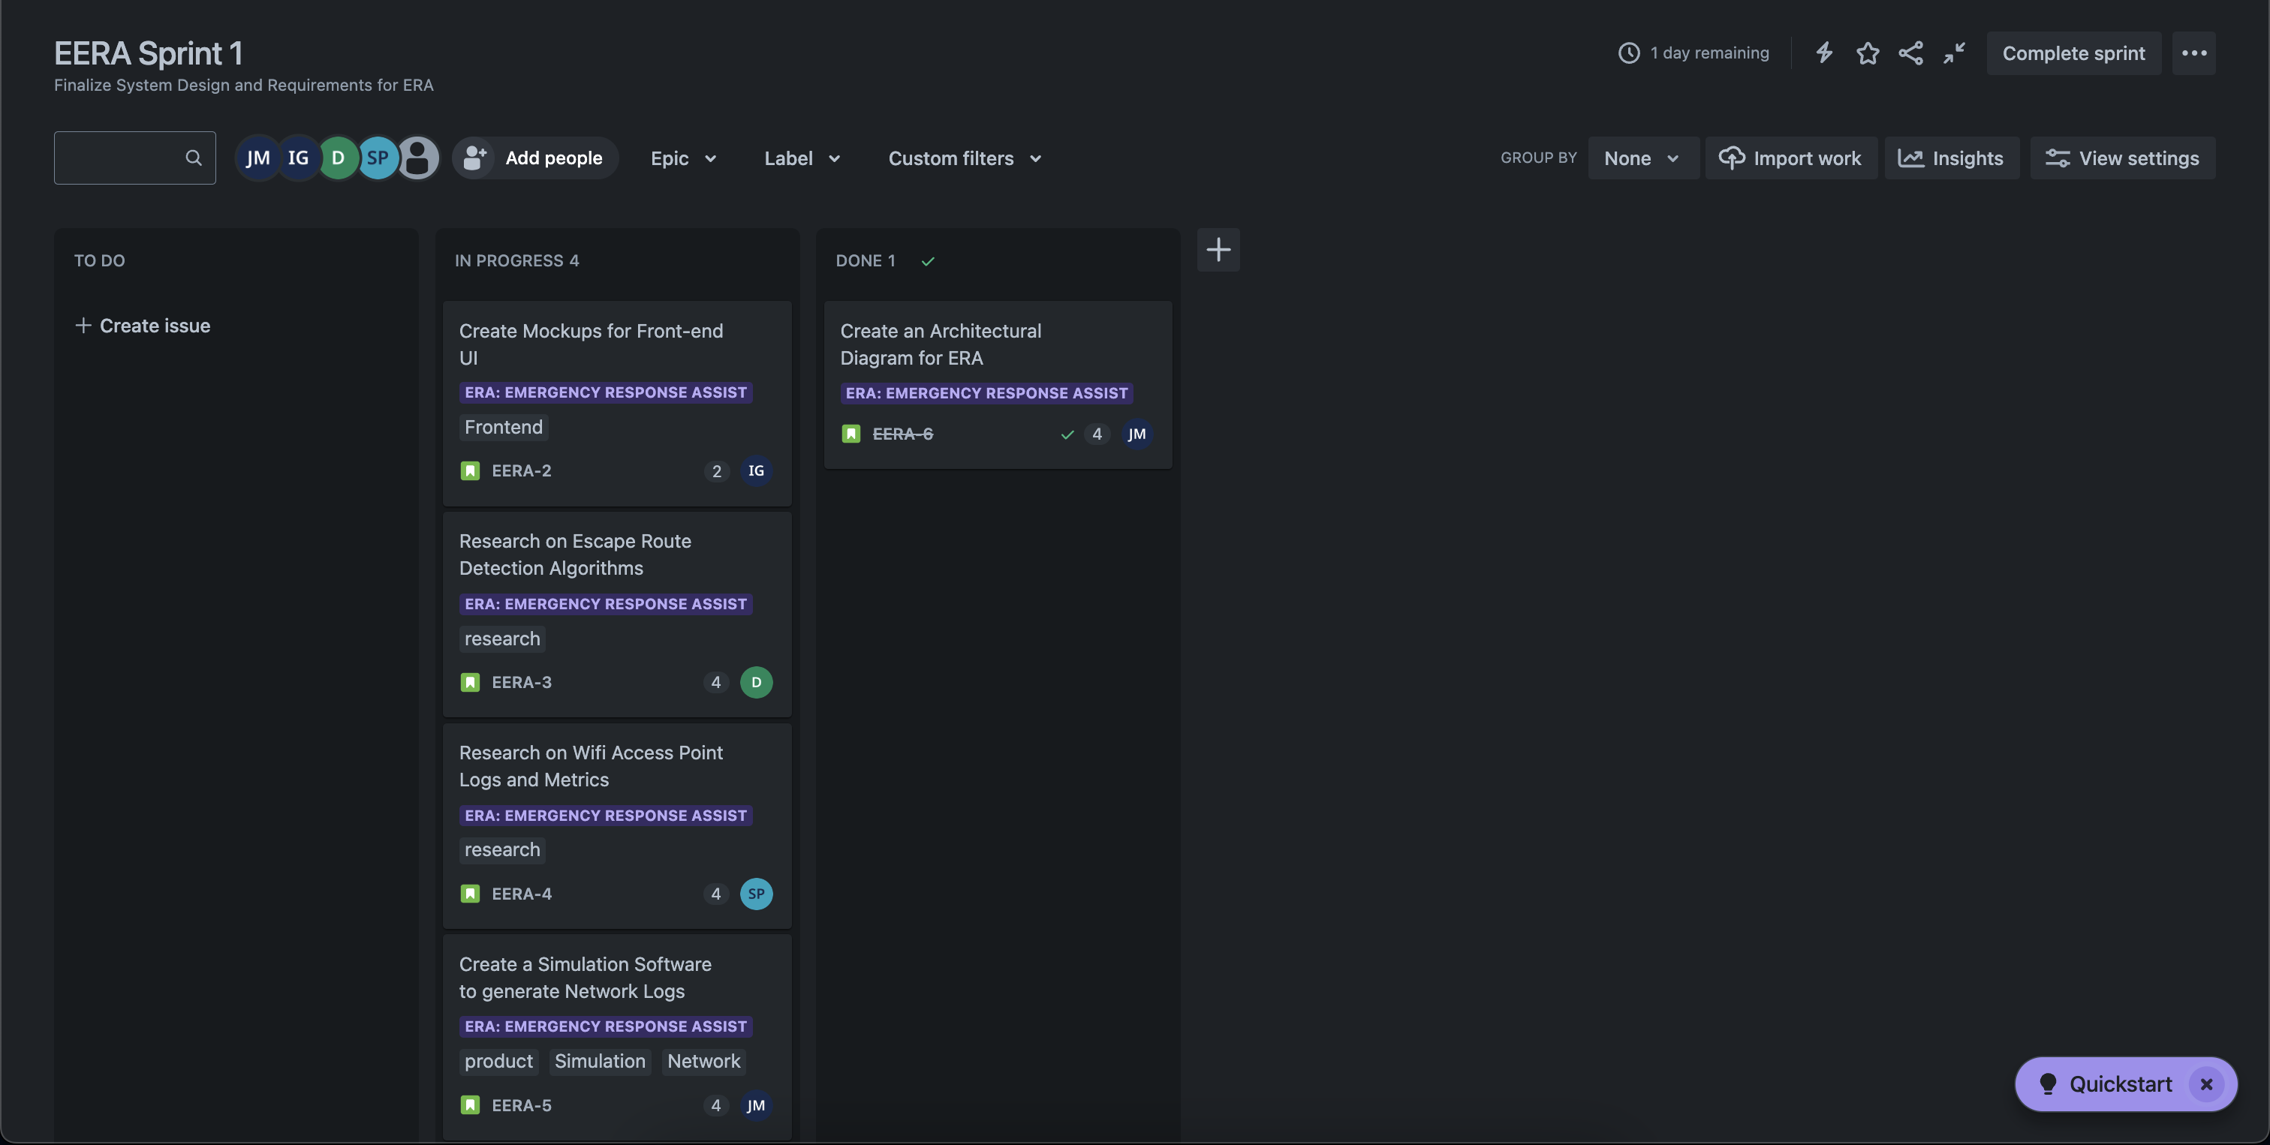
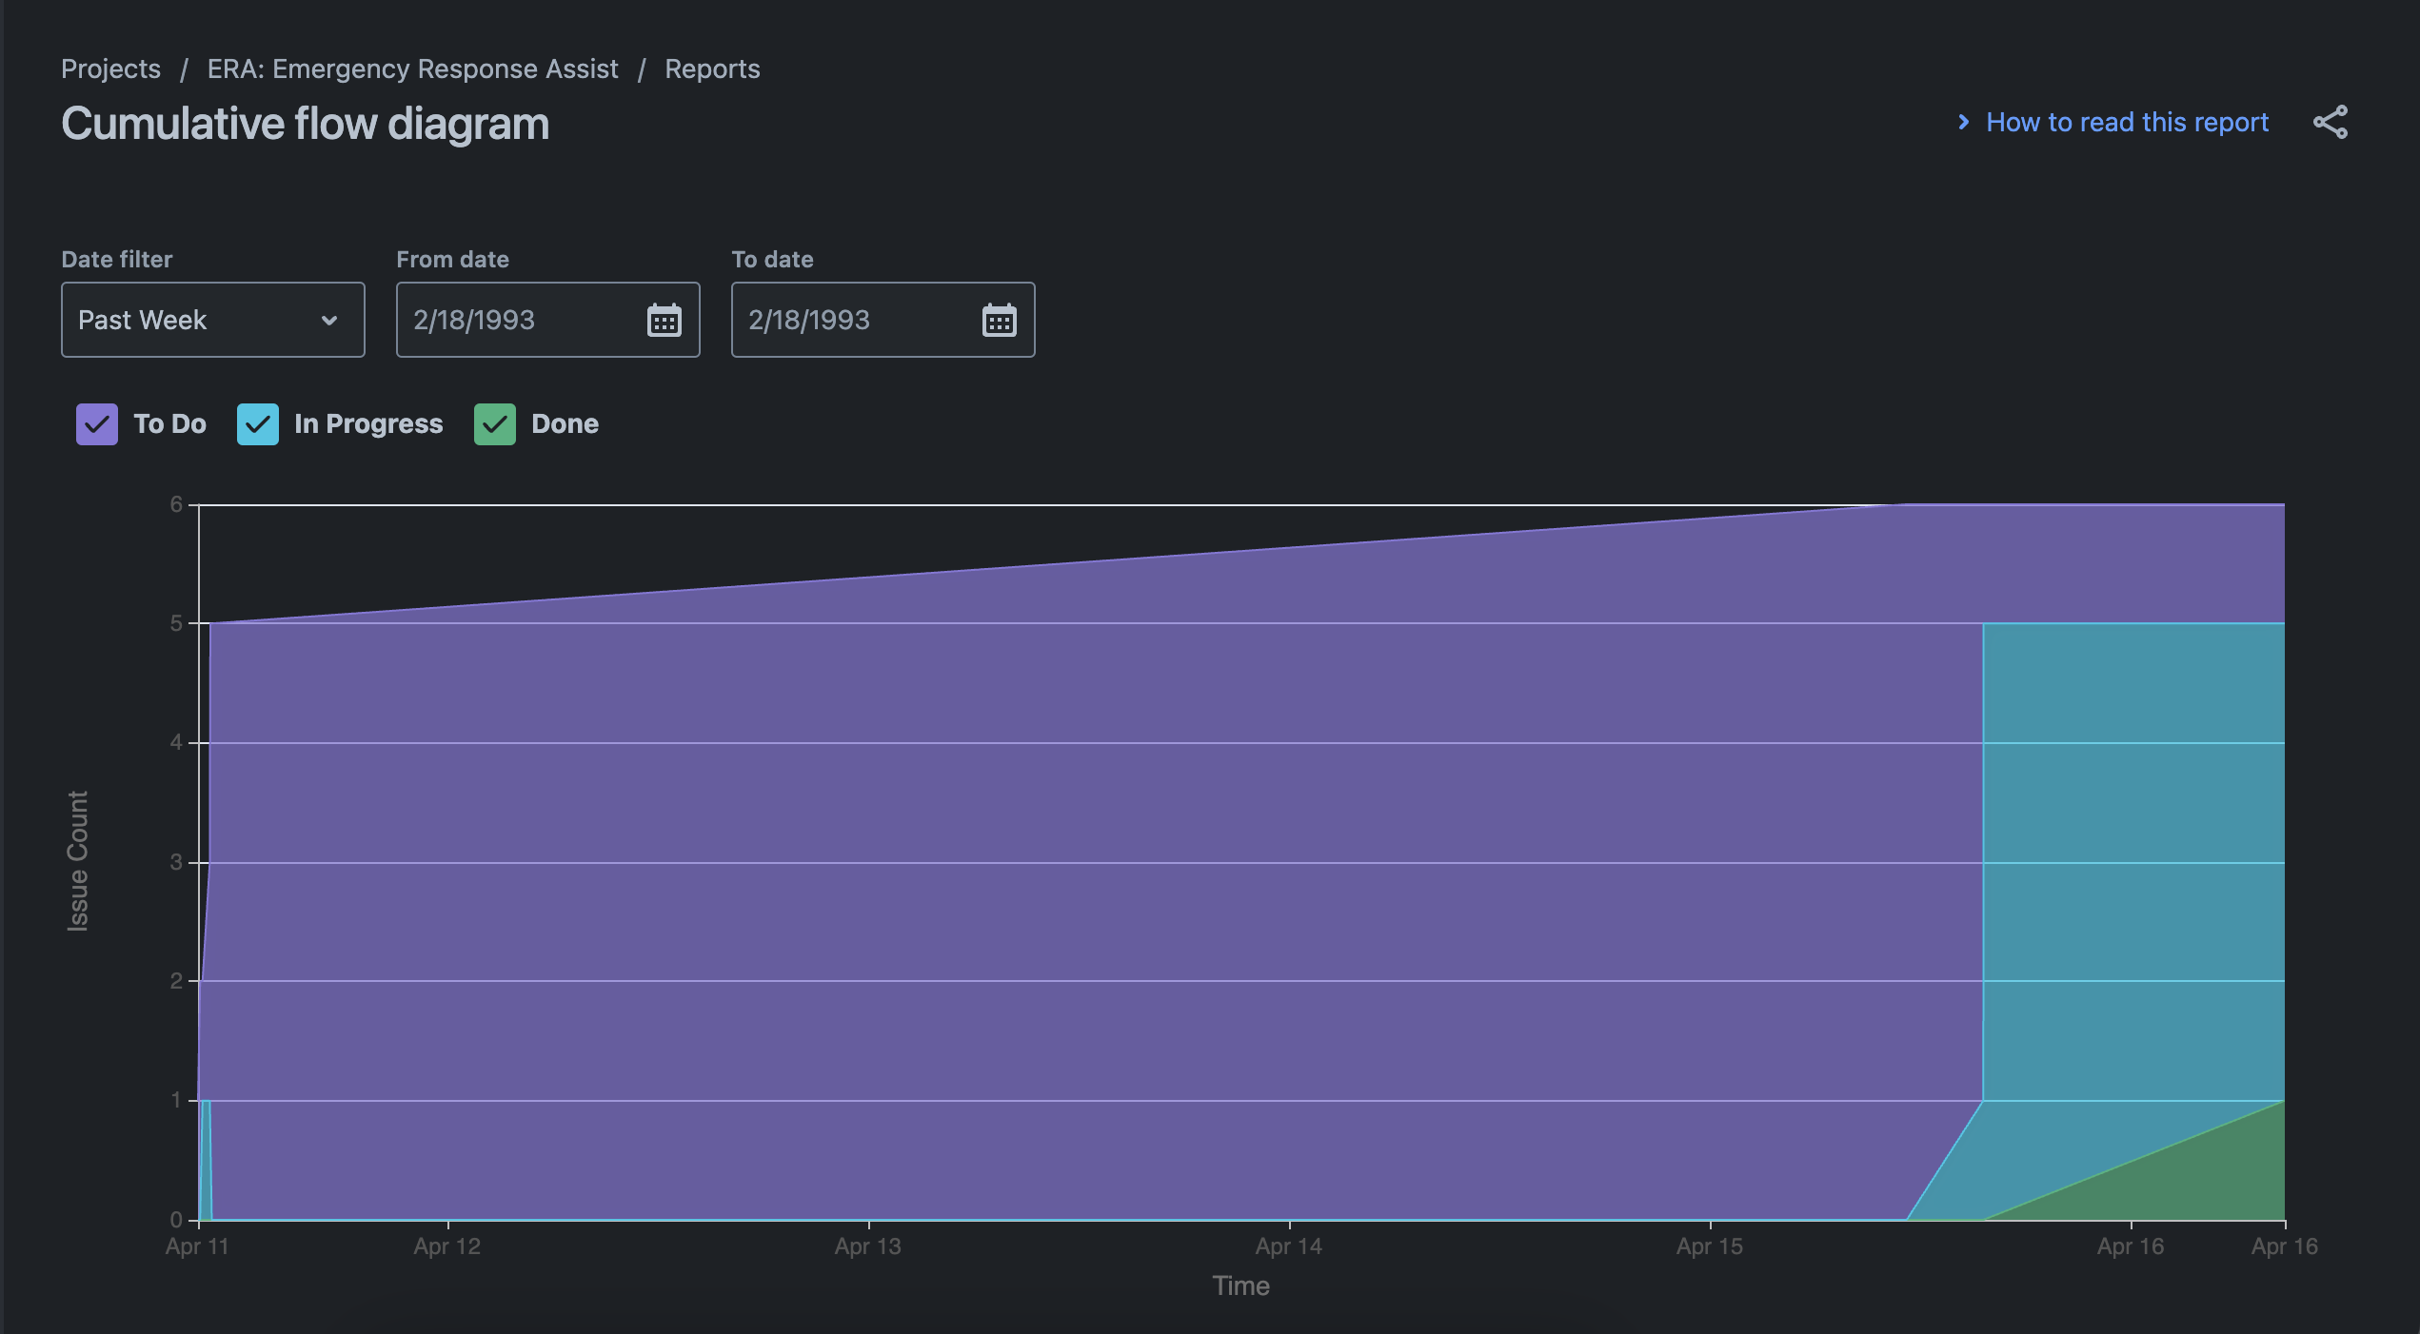
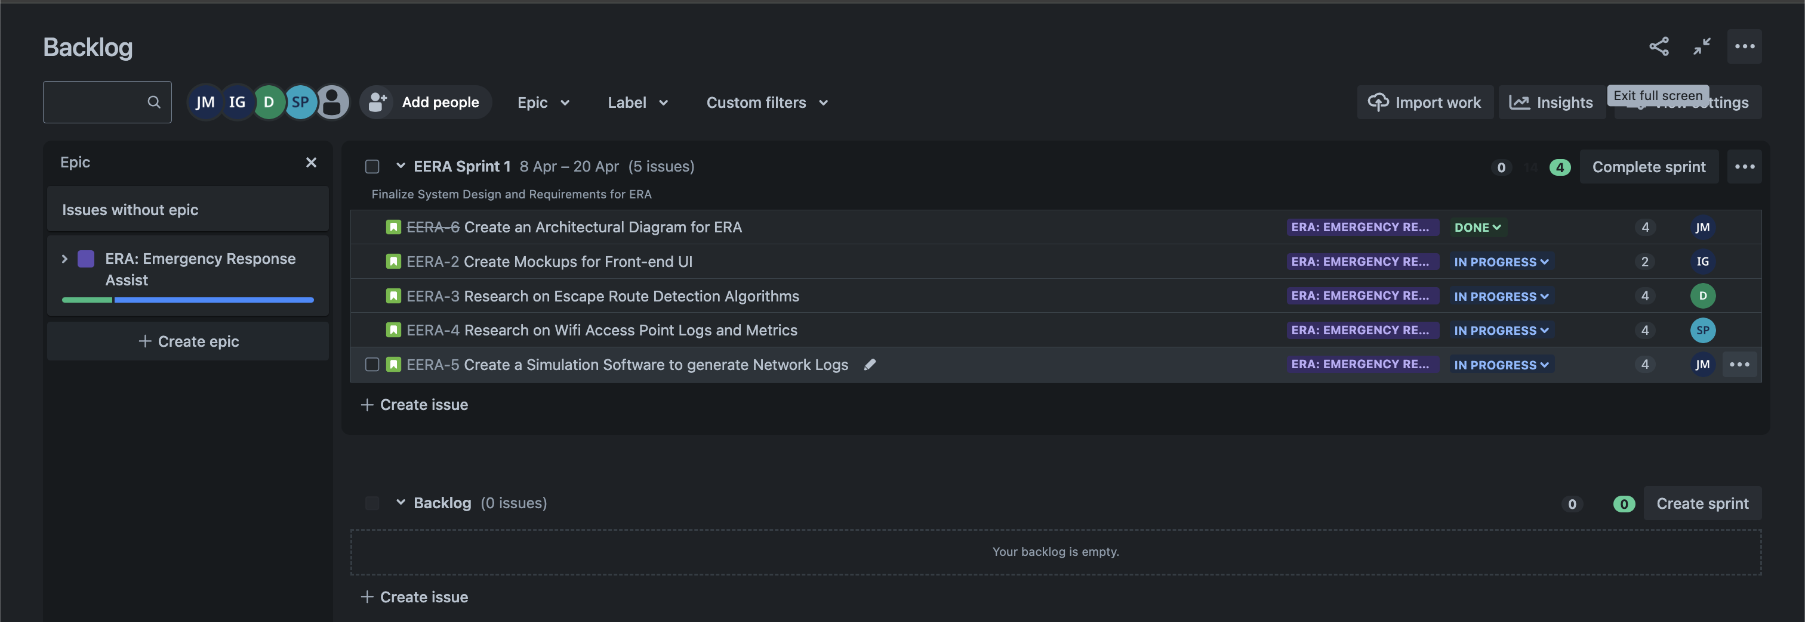
Sprint Cumulative Flow Diagram

Slide 6
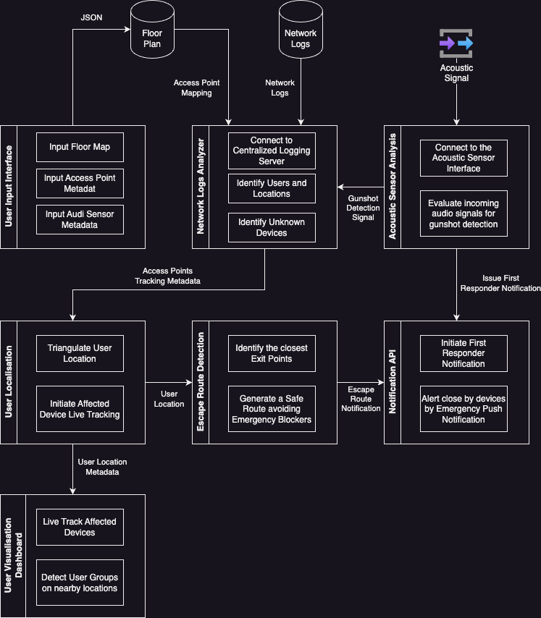
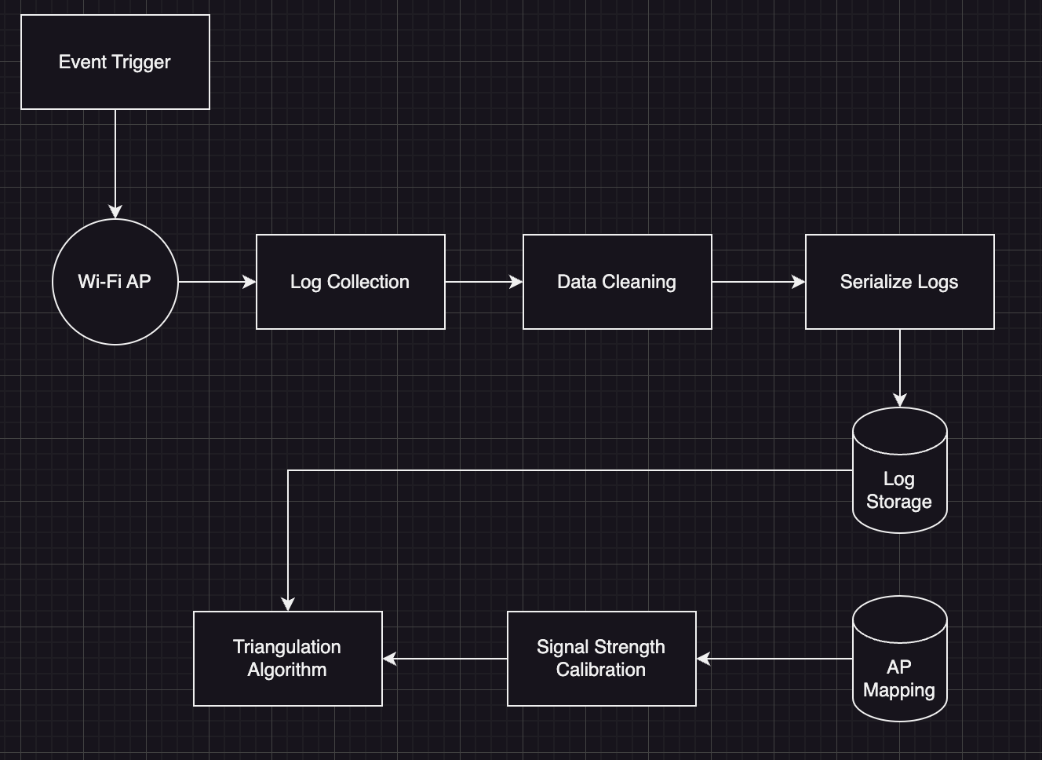
Architecture Diagram
Network Logs Analysis

Slide 7
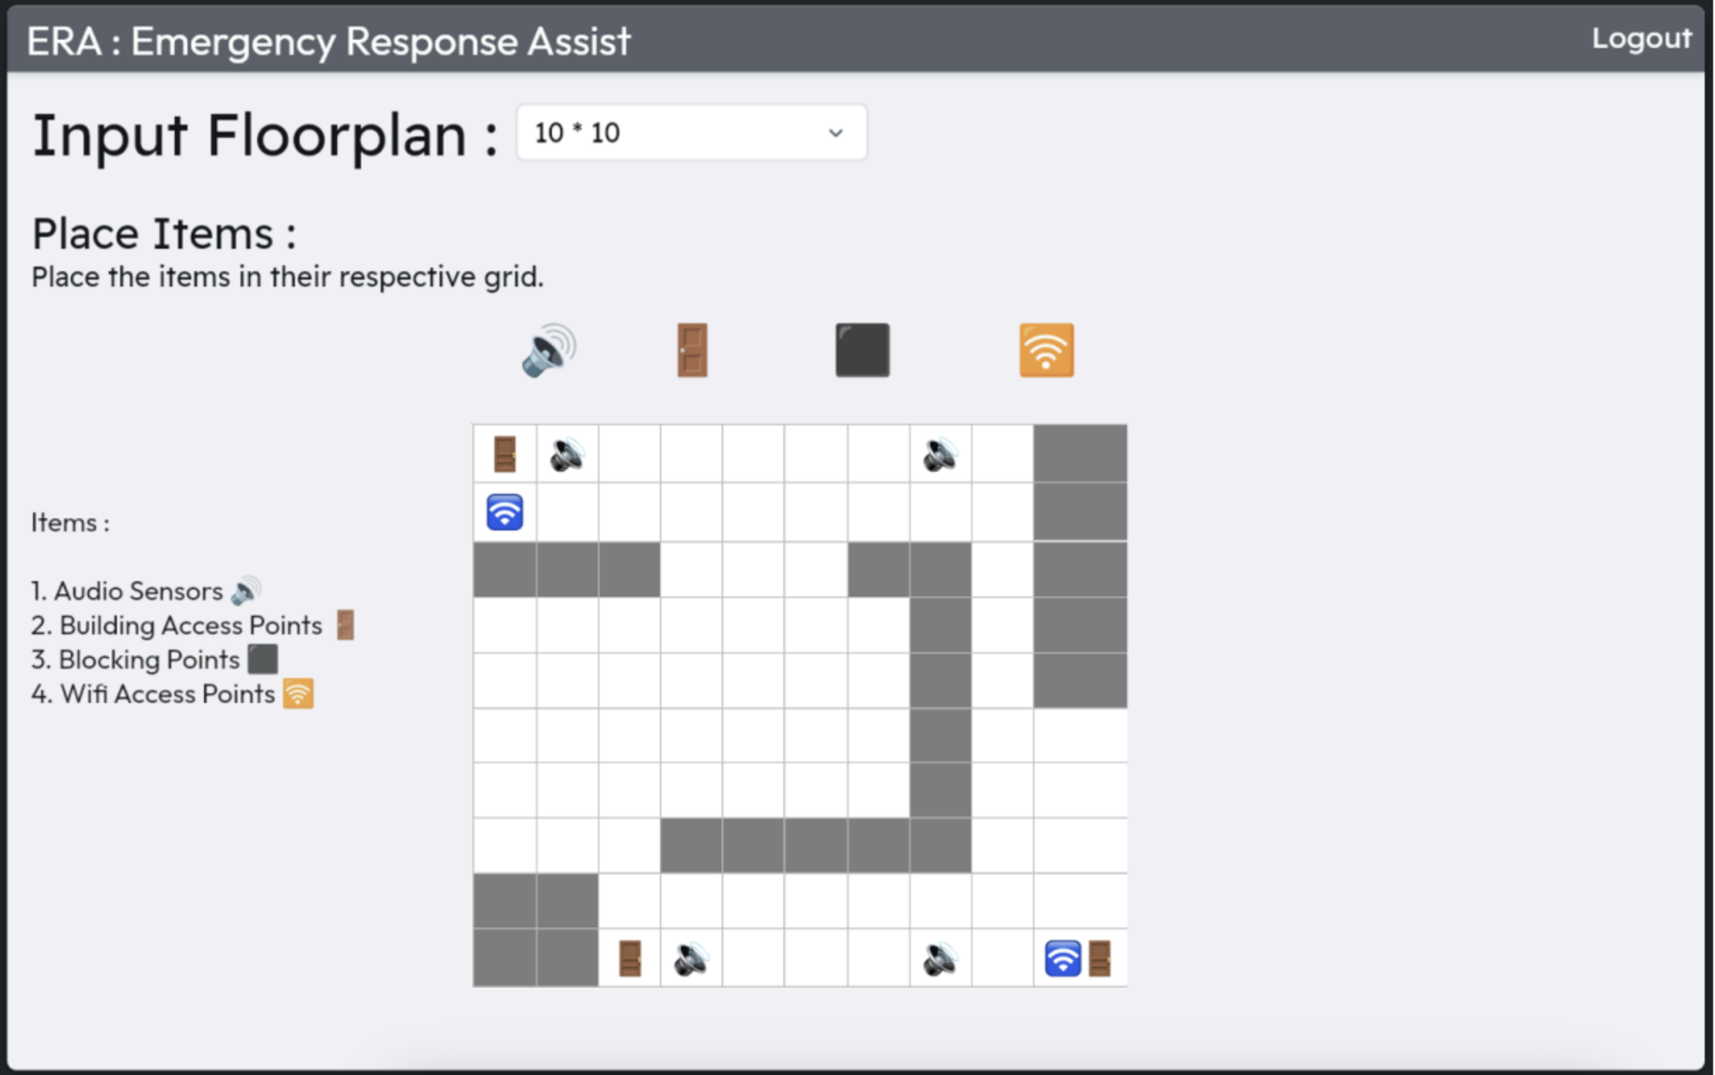
ERA: UI Mockup

Slide 8

Questions?

